Slide 1

InterviewReady App
Centre for engineering education research
Social Innovation And Practice
UNDER THE SUPERVISION OF THE COURSE COORDINATORS :-
G. Karthik Reddy (ECE)
B. Balakrishna (EEE)
K. Raju(ECE)
TEAM 10:-
Darshan S Kagi - 22H51A6676
P Sharath Kumar Reddy - 22H51A66B6
Kudupudi Sai Durga Ram - 22H51A6695
Yedla Nikhitha - 22H51A66C8
Varnika Pandey - 22H51A66C6
Krishnaya Priya - 23H55A6610

Slide 2
Content:-
Problem statement
Need statement
Existing solution
Gaps in existing solutions
Proposed solutions
Compounds required
Block diagram
Advantages and Disadvantages
Cost estimated
Plan of action
Conclusion
Reference

Slide 3
Problem statement
The process of preparing for interviews is often challenging and requires significant dedication and effort. Despite the availability of numerous resources, there is a lack of a centralized, efficient, and effective platform that can aid in this preparation process. The need for a comprehensive tool that provides a wide range of interview questions and answers, caters to various skill levels, and enhances the learning process is evident.

Slide 4
Need statement:
There is a pressing need for a comprehensive, user-friendly, and efficient tool that can aid individuals in their interview preparation process. This tool should provide a wide range of interview questions and answers, cater to various skill levels, and enhance the overall learning process. The tool should be designed using a high-performance, cross-platform framework such as Flutter, and a robust programming language like Dart, both developed and maintained by Google and Kotline. The need extends to ensuring that the tool is not only functional but also boosts user confidence and readiness for interviews. The tool should effectively consolidate resources, streamline the preparation process, and ultimately, contribute to the success of users in their interviews.

Slide 5




Existing solution
Glassdoor :- This app gives you all the required insights into the company such as the latest job listings, company reviews, interview experiences, and even salary reports.
CV Engineer :- This app helps you create a professional resume for your job application.
LinkedIn :- This app helps you connect with professionals and learn about job openings.
Indiabix :- applications that help you to prepare for aptitude tests along with job interviews.

Slide 6
Gaps in existing solution
Glassdoor: While Glassdoor provides valuable insights into companies and job listings, it does not offer personalized interview preparation resources. Users may have to sift through a lot of information to find relevant interview experiences.
CV Engineer: This app focuses on resume creation but does not provide comprehensive interview preparation resources. It lacks features like mock interviews, aptitude tests, or a repository of potential interview questions.
LinkedIn: LinkedIn is a great platform for networking and job searching, but it does not offer dedicated interview preparation tools. It lacks features like interview simulations, aptitude tests, or a repository of potential interview questions.
Indiabix: While Indiabix provides aptitude tests and interview preparation resources, it may not offer personalized learning experiences or company-specific interview preparation. It also lacks features like resume building or professional networking.

Slide 7
Proposed solutions
In this system, users can access the system by logging in with their username and password. If they are not registered, they will need to complete a registration process by providing basic details.
We are considering implementing four primary options, with the potential for additional features in the future:
Explore Problems: This feature will enable users to explore a variety of problems.
Discussion: Users can engage in discussions on various topics.
Profile: Users will have access to their personal profiles, where they can track their progress.
Report a Bug: This option allows users to report any issues they encounter.

Slide 8
Within the "Explore Problems" section, users will encounter five distinct options:
Problem Set: A curated collection of problems.
Problem Topics: Problems categorized by topics like arrays , strings etc.
Problem Difficulty: Problems classified by difficulty levels.
Random Question: An option to generate random questions for users to solve.
Featured Lists: It will the most popular Problem sheet.
Additionally, the system will send alerts to users regarding upcoming coding competitions on competitive websites.

Slide 9
Compounds Required
Laptop
Android Studio
Kotlin
Firebase Authentication
Firebase Firestore (Cloud storage)

Slide 10
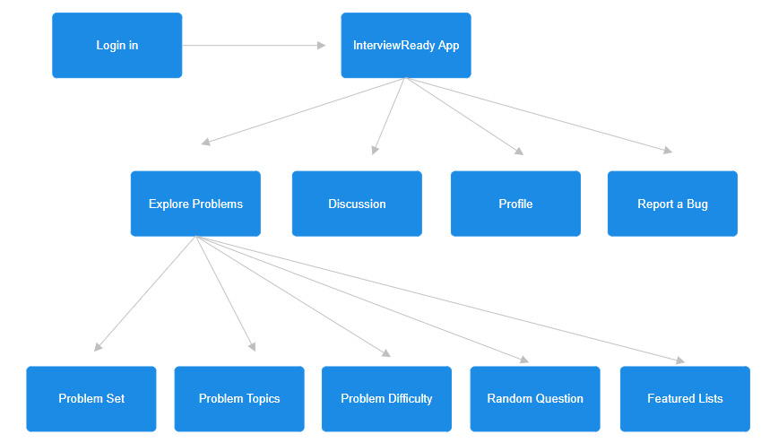
Block Diagram / Flow chart

Slide 11
Advantages and Disadvantages
Advantages
Competitive Alerts
Bug Reporting
Community Engagement
Comprehensive Problem Sets
Disadvantages
Limited to Coding Practice
Quality of Problems
App Maintenance

Slide 12
Cost estimated
2 thousand rupees for the playstore fee.
Cost of firebase is based on the number of installs.

Slide 13
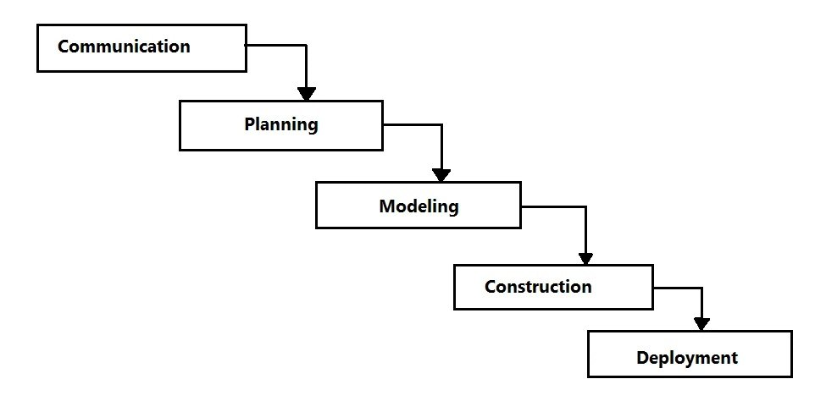
Plan of action
Communication :-Get everyone on the same page and know what needs to be done.
Planning:- Make a plan for the project.
Modeling:- Plan how the software will look and work.
Construction :- Start building the software.
Deployment :- Get the software ready for people to use.

Slide 14
Conclusion
In summary, our interview preparation app is your go-to resource for acing interviews. With a user-friendly interface and a wealth of tools, we've got your back. We're here to boost your confidence and increase your chances of success. As the job market evolves, we're here to adapt and help you stand out. With our app, you're well-equipped to conquer interviews and leave a lasting impression on potential employers.

Slide 15
Reference
https://www.interviewbit.com/
https://github.com/
https://firebase.google.com/docs/firestore/billing-example
https://www.appshive.co/apps/business/interview-preparation

Slide 16
Thank you

